Slide 1


PROJECT EXHIBITION
REVIEW 3
DNS Spoofing
Detection Protection Tool
GUIDED BY-
Dr. Hariharasitaraman.S, SCSE, VIT Bhopal
University.

Slide 2

Team members
Sarthak Yadav
Raghunandan Tomar
Vakul Raina
Aryan khatik
21MEI10036
21MEI10024
21MEI10040
21MEI10004

Slide 3



CONTENTS
·Introduction
·Existing work with limitations
·Proposed work and methodology
·Novelty of the project
·Real time usage
·Hardware & software requirements
·Overall system architecture diagram.
·Literature review
·Module
·Implementation and Demo with module work flow explanation.
·Conclusion.

Slide 4
Introduction
DNS stands for Domain Name Server. So, DNS spoofing is an attack wherein the attacker can redirect the victim to another website which is not intended to be visited by the victim by injecting a fake DNS record in the DNS cache. As a result of these fake DNS entries, the victim can be redirected to any IP of the attacker’s choosing.
This attack can be easily performed in the Kali Linux environment using various inbuilt tools.
One such tool that we used is Ettercap. Using ettercap, we first poison the victim’s ARP cache with our MAC address.
Then we search for available hosts inthe network and add the gateway as TARGET2 and the victim as TARGET1 and start unified sniffing.
Finally we add the dns_spoof plugin that is available in ettercap and wait for some time for it to start.
Once we get the message that the target website’s DNS has been spoofed, we can check the victim machine and try opening the website in it. We observe that the victim is redirected to some other website even though the address bar says that it is the original website.

Slide 5

Existing work with limitations
Mitigation tactics
Disadvantages
Coarse gain filtering also hitting legitmate traffic
Cannot completely eliminate malicious traffic
Rate limiting
Filtering
Cannot distinguish between malicious and legitmate traffic

Slide 6
Real time usage
Common risks of DNS poisoning and spoofing:
Data theft
Malware infection
Halted security updates
Censorship
DNS spoofing poses several risks, each putting your devices and personal data in harm’s way.
Data theft can be particularly lucrative for DNS spoof attackers. Banking websites and popular online retailers are easily spoofed, meaning any password, credit card or personal information may be compromised. The redirects would be phishing websites designed to collect your info.
Anti Dns protects its user from all these risks mentioned above

Slide 7
Hardware & software requirements
Hardware
Intel i5-9300H processor
8 GB RAM
Software
VMware workstation 15
ISO file of kali, Ubuntu and windows7
Ettercap, arpspoof, setoolkit and browser (included with kali)
Python 3.7
Any text editor

Slide 8
Objective
Protection of the confidential information of the users is crucial to prevent certain cyber attacks. In the DNS poisoning attack, end-users are particularly vulnerable.
We have made a simple python program that browses different IP addresses in the ARP cache and checks if any two IP addresses have the same MAC addresses or not. If the have the same MAC address, that means the ARP cache is poisoned.
Once the poisoning is confirmed, the user is prompted with a message saying that the ARP cache has been poisoned. Along with this message, the attacker’s MAC address is also displayed.

Slide 9
Problem Statement
Even though these attacks have a limitation of only
working on LAN, these are very common and easily
performed and virtually undetectable by a novice. As a result, this is a threat that has to be addressed. So, we hve come up with a python program which is capable of detecting, preventing and recovering from an ARP poisoning attack on the victim’s linux system by which man in the middle attack can be stopped and dns won't be spoofed

Slide 10
Proposed work
The objective of this project is to develop a prevention against DNS spoofing by using a python program
The program will help user from getting their Arp poisioned

Slide 11
Literature Review
Y. Kim, S. Ahn, N. C. Thang, D. Choi and M. Park, "ARP Poisoning Attack Detection Based on ARP Update State in Software-Defined Networks," 2019 International Conference on Information Networking (ICOIN), Kuala Lumpur, Malaysia, 2019, pp. 366-371, doi: 10.1109/ICOIN.2019.8718158.
B. Zdrnja, "Malicious JavaScript Insertion through ARP Poisoning Attacks," in IEEE Security & Privacy, vol. 7, no. 3, pp. 72-74, May-June 2009, doi: 10.1109/MSP.2009.72.

Slide 12
Modules
There are 3 modules :
1.Detection
2.Prevention
3.Recovery

Slide 13
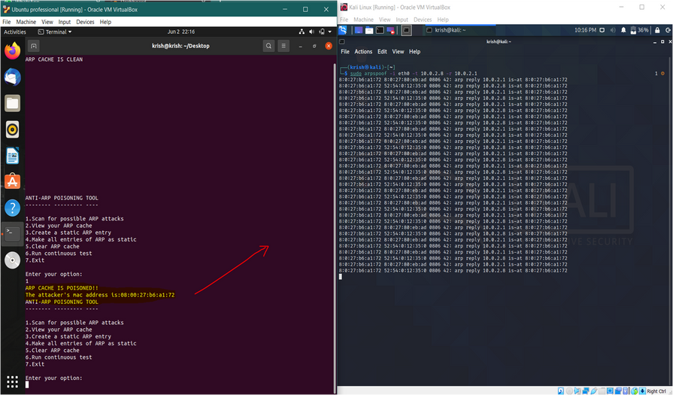
Implementation and Demo
Detection of attack :-
Figure 2 Attack Detected

Slide 14
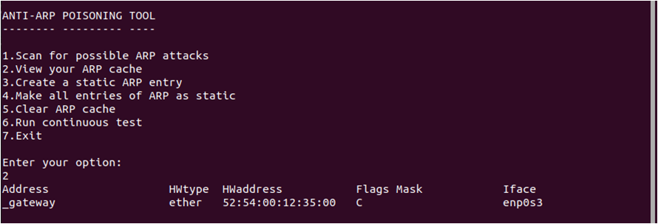
Prevention :-
First we’ll observe the ARP cache.
Here the flag masks are denoted with ‘C’, that means it’s dynamic and hence out system is vulnerable to the attack.
Figure 3 Poisioned Arp

Slide 15
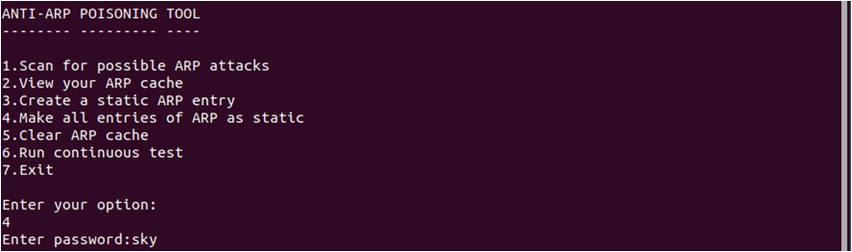

Now, in order to prevent the attack from being performed, we have to change the ARP cache from dynamic to static.
Figure 4 Create a static entry

Slide 16
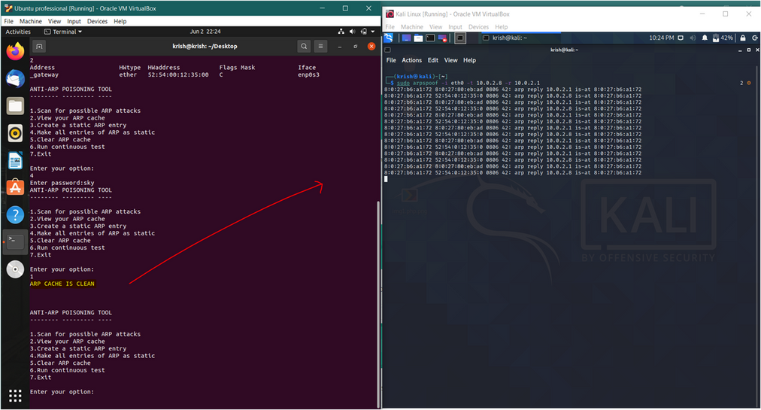
Here as we can see, even if we perform the attack, the ARP cache is clean.
Figure5 Clean cache

Slide 17
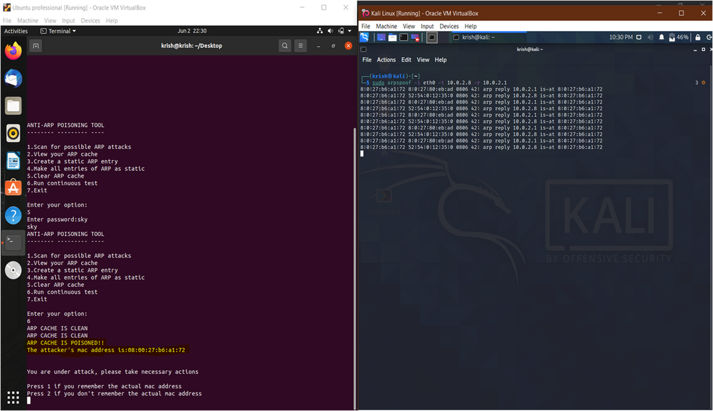
Recovery :-
Here we have an option to run the test continuously.
Figure6 Continious test

Slide 18
Now once the attack is detected, it will ask us if we remember the actual mac address. In this case we don’t.
So the system will find the actual MAC address from the previously stored clean set of values and restructure the ARP cache.
Once this is done, our ARP cache is clean again, as it was before the attack happened.

Slide 19
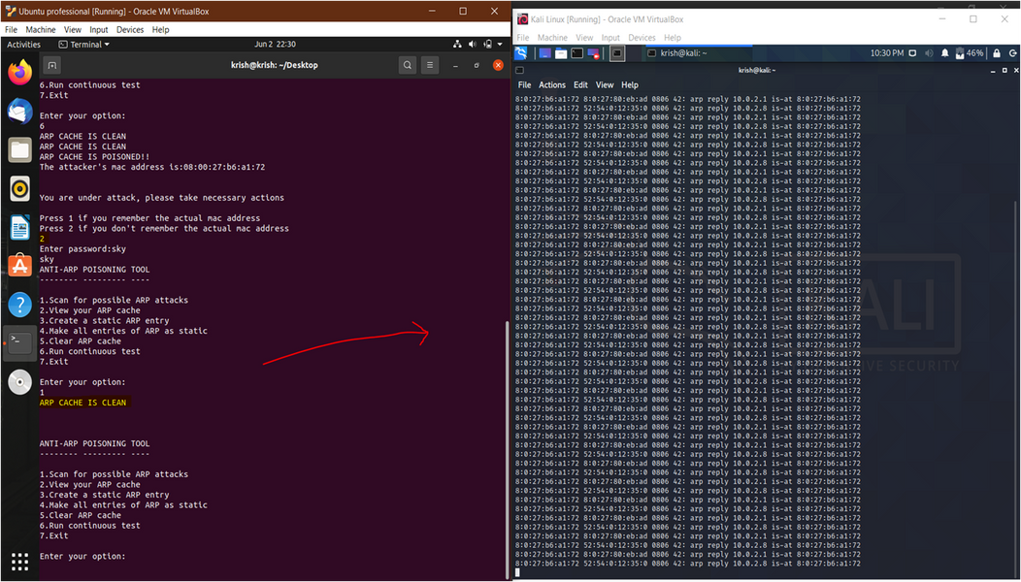
Figure7

Slide 20
Code :-
click the link to view the code
https://drive.google.com/file/d/1y2q3XeDSsrZAV7HL9KzJQQBWnQ7mUlbC/view?usp=sharing

Slide 21
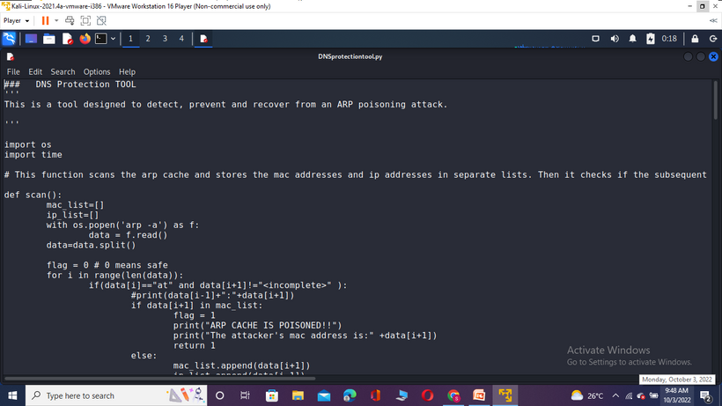
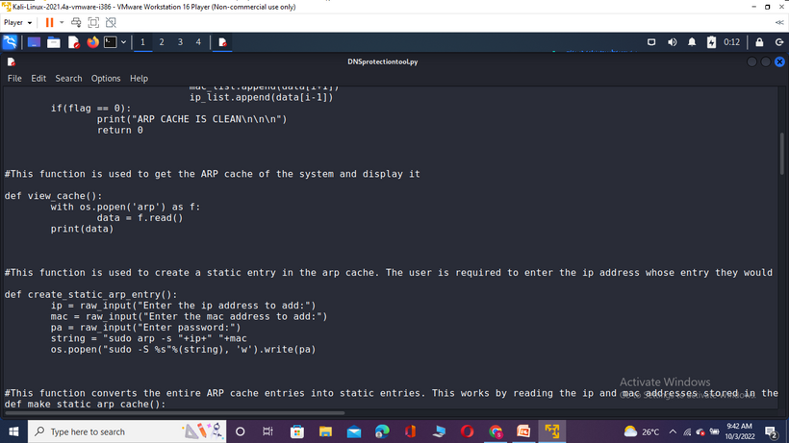
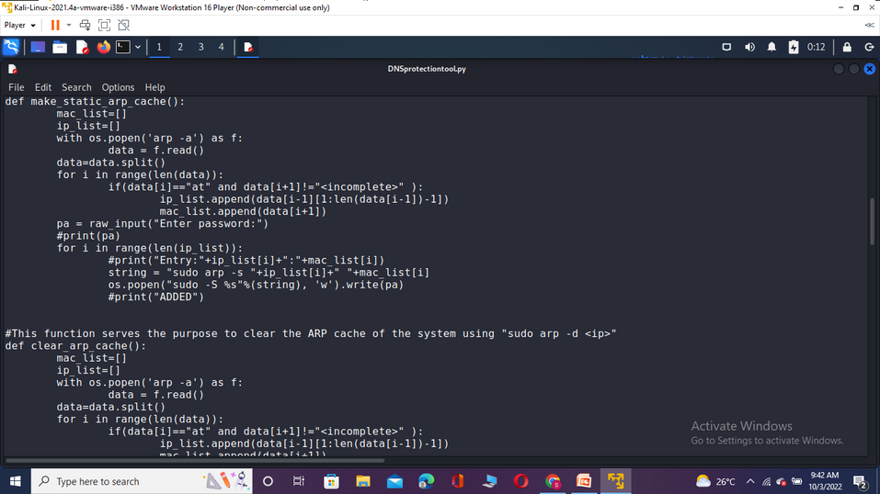
Coding

Slide 22
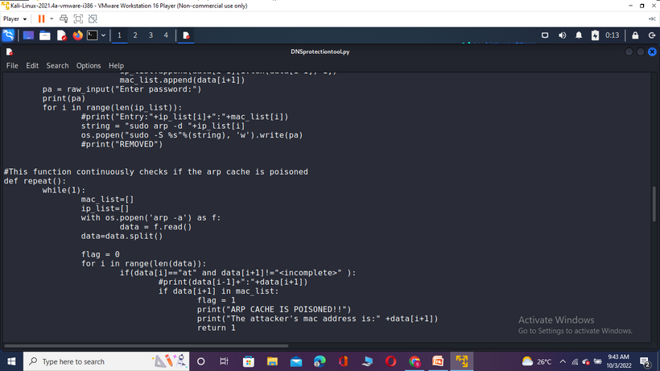
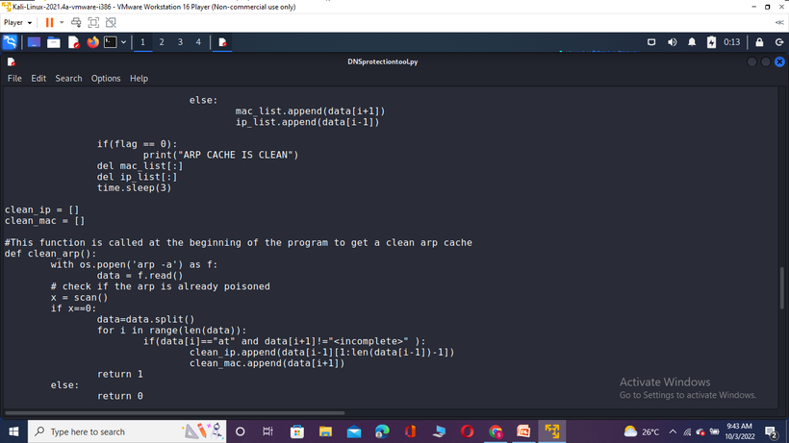
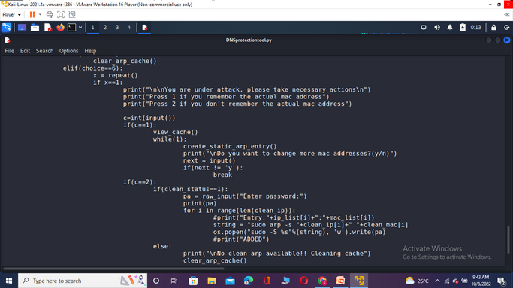
Coding

Slide 23
Conclusion
In this project, we have successfully implemented ARP poisoning, DOS, and DNS poisoning attacks. We have also recordedthe procedure and explained it step-by-step in great detail.Even though these attacks have a limitation of only working on LAN, these are very common and easily performed and virtually undetectable by a novice. As a result, this is a threat that has to be addressed. So, we have come up with an app “anti-arp” which is capable of detecting, preventing and recovering from an ARP poisoning attack on the victim’s Linux system. This is written in python and mainly focuses on analyzing the ARP cache of the system to detect attacks. Also thereare functions which have the capability of performing continuous scans after a certain regular interval of time.

Slide 24
Refrences
[1] Y. Kim, S. Ahn, N. C. Thang, D. Choi and M. Park, "ARP Poisoning Attack Detection Based on ARP Update State in Software-Defined Networks," 2019 International Conference on Information Networking (ICOIN), Kuala Lumpur, Malaysia, 2019, pp. 366-371, doi: 10.1109/ICOIN.2019.8718158.
[2] B. Zdrnja, "Malicious JavaScript Insertion through ARP Poisoning Attacks," in IEEE Security & Privacy, vol. 7, no. 3, pp. 72-74, May-June 2009, doi: 10.1109/MSP.2009.72.
[3] S. Kumar and S. Tapaswi, "A centralized detection and prevention technique against ARP poisoning," Proceedings Title: 2012 International Conference on Cyber Security, Cyber Warfare and Digital Forensic (CyberSec), Kuala Lumpur, 2012, pp. 259-264, doi: 10.1109/CyberSec.2012.6246087.

Slide 25
Thank
you!

